Slide 1
Castle Primary School Parent/Carer Survey 2021
‘Outstanding school, friendly, helpful, knowledgeable and caring’ (Yr 2 Parent).

Slide 2
Thank you
Thank you all for completing this questionnaire to help us to understand the views of our parents and carers. We have found this process incredibly helpful in focussing future work. We would also like to those of you who made offers for support in various ways and who included information about the successes of your children for us to celebrate in assembly. Please do not hesitate to continue to make contact via the school office if there is anything you feel we should know about your child’s successes, struggles, or changes at home that may be impacting them. We feel communication is key to our success and thank you for continuing to support us in these difficult times.

Slide 3
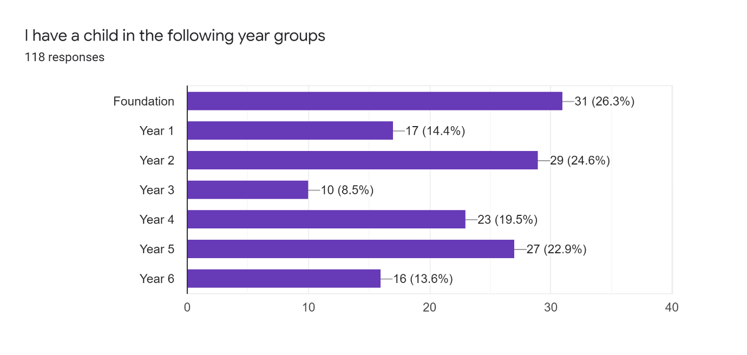
Survey conducted in November 2021
118 responses

Slide 4
AREAS COVERED IN THE SURVEY
Teaching and Learning | Communications
Pupils and pastoral care | Leadership and management
Greatest Strengths | Community Involvement

Slide 5
Summary of Responses
Positives
97%- respondents either agreed or strongly agreed with the statement ‘my child is happy at this school’
99% respondents either agreed or strongly agreed with the statement ‘my child feels safe at the school’
96% of respondents felt that their child was making good progress. 1% did not know. 3% felt their child was not making good progress.

Slide 6
Some concerning areas
Communications were identified as an issue in some responses
‘I don’t feel the school follow through ,they say they’re going to put things in place but they don’t actually do it, and they do not communicate back to tell you what they have changed and put in place for them if any. It’s all talk . I love this school but this year it’s not been great for my child)
‘ We have really poor communication as very last minute with information’

Slide 7
Some concerning Areas
Extra curricula activities were a common theme raised as an issue;
‘No after school activities…’
‘ I would love to see opportunities for peripatetic music lessons as the children don't seem to learn an instrument together in class anymore? Also language learning from lower down in the school’

Slide 8
Teaching & Learning
 | Agree | Disagree | Neither agree or disagree | Strongly agree | Don’t know | maybe | Strongly disagree
My child makes good progress at the school | 46 | 2 | 9 | 58 | 1 |  | 1
The school informs me about my child’s progress | 50 | 7 | 21 | 39 |  |  | 1
The school has high expectations for pupil achievement, progress and behaviour | 50 | 2 | 18 | 42 | 3 |  | 2
The school helps me to support my child’s learning | 48 | 5 | 16 | 49
There is a good range of subjects available to my child at this school | 52 | 4 | 12 | 43 | 3 |  | 2
This school makes me aware what my child will learn during the year | 55 | 6 | 10 | 46
The school is helping my child to have a love of learning | 49 | 2 | 13 | 53 |  |  | 1

Slide 9
Teaching & Learning
I would like my child to be given wider opportunities such as instrument lessons, music clubs, choir, forest schools. I feel this is really lacking at this school and it is a shame’.
‘I would love to see opportunities for peripatetic music lessons as the children don't seem to learn an instrument together in class anymore? Also language learning from lower down in the school’
‘Learning to play a musical instrument even if we need to pay would be good’
‘No after school activities. Need to be kept up to date with the learning from the National Curriculum through the teacher. Learning seems to be limited as some of the learning is pre school learning’.
‘No outside clubs available drama arts sports music’
‘There is a lack of after school activities such as a choir, music, drama etc’
‘I have answered this with this academic year in mind. However, I have not always felt this positive. There have been years where the quality of teaching has varied. The past two years have been much improved.

Slide 10
Teaching & Learning
‘I really look forward to being invited back in to see my child's work when possible! The children's work on the Remembrance video was lovely. More of this would be good!’
‘I'd like to say that overall we are very happy with the school. Our children are happy here and we have regular contact with our children's teachers about their progress & learning.
‘I do think if a parent has expressed a particular area of interest for developing their child's learning, it would be more progressive if that learning could be more tailored passed the learning requirements, especially if the child is advanced in that area, as often I have asked and just been told they need to focus on such and such, but they can already do this well and thus get bored with the task as they find little interest in doing it again and then start to lose passion for it’

Slide 11
Teaching & Learning
‘I understand that it has been challenging to include parents in school life since covid. I really miss the children getting into their lines in the mornings and face to face contact with staff. Parents evenings are great but I would like more contact in between. Both my children read each night but I would love to know how to support them in other areas such as maths. I really hope school life can return to a more normal next year’
‘I would like to know more about what my child learning at school’
‘It's a shame parents evening was done on the phone again this year when other school have done face to face, drop off still being at the gate, rather then dropping to class etc, understand during covid but feels like these rules with remain as the school prefers it’

Slide 12
Teaching & Learning
‘Overall structure for this year group seems distant from other year groups. Learning doesn’t flow or follow a logical approach. Making a potato super hero is not what I would call adequate, this is stuff which was done at nursery, my daughter is now in a school environment and should be learning more in this way. Why can my child not choose what she wishes to read with guidance?’
‘Overall I am happy but I did not get to talk to my child’s teacher on parents evening as he could not get through to me. I have also a home number but this wasn’t tried and also a work mobile.
‘I would like to have been approached by him after school maybe to say he would talk to me another time or give me some kind of information instead just messages were left that he couldn’t get through because of his reception. Each time my phone did not even ring it wouldn’t connect at all so as I say maybe try the other numbers??’

Slide 13
Teaching & Learning
Suggestions for responding to comments

Slide 14
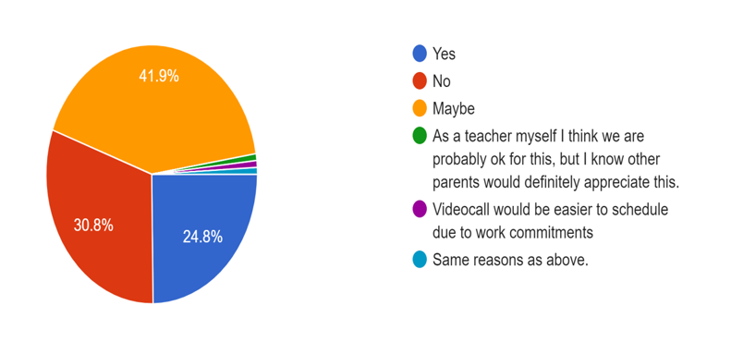
Supporting Parents and Children
Would you be interested in attending a class or session on how parents or family members can help their children learn at home?

Slide 15
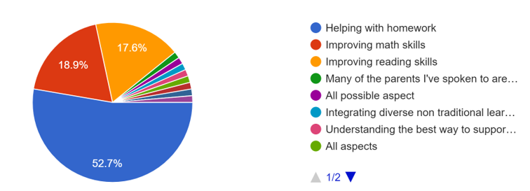
Supporting Parents and Children
If you would be interested in attending a class or session on how parents or family members can help their children at home – which of these would you be interested in?

Slide 16
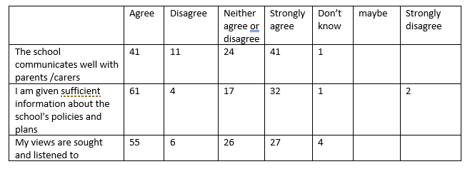
Communications

Slide 17
Additional Comments on Communications
‘I can't agree with a lot of these as everything is online now and I don't always have access to internet, I think it's ridiculous that this school has scrapped standard newsletters being sent home in the child's bookbag. That always helped to keep up to date on what was going on at the school. They seem to have forgotten that not everyone has access 24/7 to the internet’.
‘My only query is about how I would find out information such as the school's behaviour, diversity, equality etc’
– ‘Regarding consent for pictures and video to be made available, I would like to see more flexibility in options. I am happy for my child to appear in the school website but not the Facebook page. There is no way to make this distinction. I was also not made aware of what my choice would mean so I was disappointed that my daughter was not included in a class photo. I have now had to agree to Facebook so I can see my daughter in the Nativity, but I'm not comfortable with this’
‘I feel I could know more about my child's time at school and how they are getting on. I feel parent partnership could be better. I never got to visit the school before my child started and parents evening was via phone call but would have been better in person. I feel covid is not a good enough excuse anymore for parents missing out on their child's education and being involved in their school life.’ -- - - Some neither agree or disagree answers.

Slide 18
Suggestions for responses welcome Communications

Slide 19
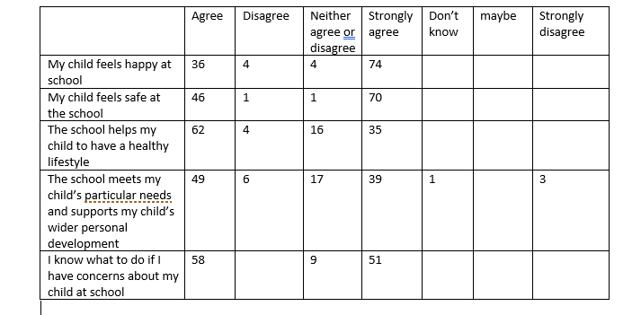
Pupils and Pastoral Care

Slide 20
Additional comments on ‘Pupils and Pastoral Care’
‘I am concerned about the recent information regarding coughs and colds. I understand that in the current situation regarding covid we need to be careful but I feel that having to keep our children off school and having to do PCR tests is a bit much, if they have a temperature and are unwell then I understand but my child has allergies and is on an inhaler so when he catches a cold which is quite often it ends up on his chest and he ends up with a cough I am very concerned as this will mean he will be potentially missing a lot of school ‘.
It does worry me sometimes when my child says they see the children who have been in trouble having treats and they do not. It does seem that there are constant behavioural problems in the class and this does cause some disruptions. My child has seen some aggressive behaviour on a few occasions which really upset them.

Slide 21
Additional comments on ‘Pupils and Pastoral Care’
‘Whilst I do not doubt the commitment and care of the school and their teachers, my child is struggling this year and I have found it hard to work productively with to identify what the issues are and deal effectively with them. The attitude is 'they're fine when they're here' which I recognise, but if behaviour is poor at home and they are expressing unhappiness at coming to school then there is something wrong somewhere. It can feel as though you are being dismissed as an overanxious parent when actually you know your child’

Slide 22
Suggestions for responses welcome Pupils and Pastoral Care

Slide 23
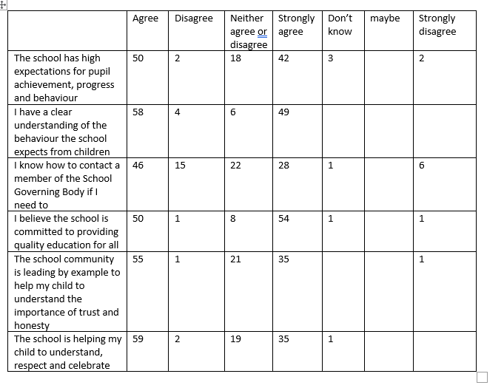
Leadership and Management

Slide 24
Leadership and Management - Comments
Only 1
4 people said they didn’t know how to contact a member of the School Governing Body if needed to.

Slide 25
Leadership and Management – Responses to comments

Slide 26
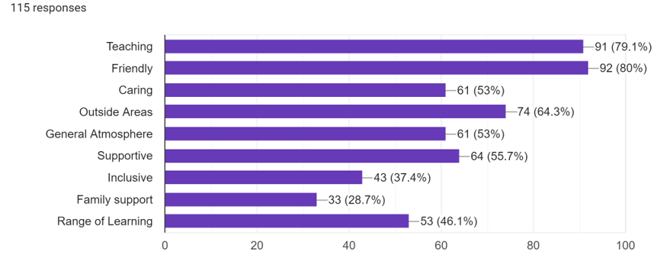
What do you consider to be the school’s greatest strengths?

Slide 27
What do you consider to be the school’s greatest strengths?
According to the feedback of the pupil survey, 80% of respondents thought Castle School’s greatest strength is that it is a friendly school.
Credit to the Teaching staff at Castle Primary School, the biggest perceived strength is the Teaching Staff with 79% of respondents making this choice.
The two lowest choices were family support receiving 29% of the votes and the penultimate choice was 46% for range of learning.

Slide 28
Community Involvement

Slide 29
